Slide 1
Abstract Window Toolkit
Session 6

Slide 2
Review
Import statements are used to access the Java packages to be used in a program.
A token is the smallest unit in a program. There are five categories of tokens:
  Identifiers
  Keywords
  Separators
  Literals
  Operators
Class declaration only creates a template and not an actual object.
Objects are instances of a class and have physical reality.
Method is the actual implementation of an operation on an object.

Slide 3
Review Contd…
Constructors are used for automatic initialization of objects at the time of creation.
The super keyword is used for calling the superclass constructors.
To inherit a class from the superclass, the extends keyword is used.
Overloaded methods are a form of static polymorphism and Overridden methods are a form of runtime polymorphism.
Java provides the following access specifiers: public, protected, private.
The following modifiers are provided by Java: static, final, abstract, native, synchronized, and volatile.
Nested class can be static or non-static.

Slide 4
Objectives
Explain Abstract Window Toolkit (AWT)
Explain various Containers and Components
  Frame
  Panel
  Label
  TextFields and TextAreas
  Checkboxes and RadioButtons
  Choice
Identify events generated by components
Create a standalone AWT application

Slide 5
Abstract Window Toolkit
Graphical User Interface (GUI) is used to accept input in a user friendly manner.
Abstract Window Toolkit (AWT) is a set of Java classes that allow us to create a GUI and accept user input through the keyboard and mouse.
AWT provides items which enable creation of an attractive and efficient GUI.

Slide 6
Containers
It is an area that can hold elements.
It can be drawn on or painted.
There is a Container class in the java.awt package from which two commonly used containers – Frame and Panel are derived directly or indirectly.
Frame is a separate window and has borders.
Panel is an area without borders and is contained within a window provided by the browser or appletviewer.

Slide 7
Containers - Frame
A window that is independent of an applet and of the browser.
It is a subclass of Window and has a title bar, menu bar, borders and resizing corners.
It can act as a component or a container
Can be created using the following constructors
  Frame()
    Creates a Frame which is invisible
  Frame(String Title)
    Creates an invisible Frame with given title
To make a Frame visible the function is:
  setVisible()

Slide 8
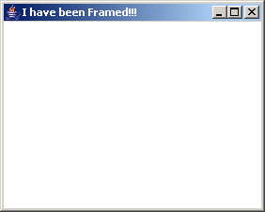
Example
Output
import java.awt.*;
class FrameDemo extends Frame
{
public FrameDemo(String title)
{
super(title);
}
public static void main (String args[])
{
FrameDemo ObjFr = new FrameDemo("I have been Framed!!!");
ObjFr.setSize(500,500);
ObjFr.setVisible(true);
}
}

Slide 9
Containers - Panel
Used to group a number of components together.
Simplest way to create a panel is through its constructor Panel().
Since a panel cannot be seen directly it has to be added to a frame.
The frame will be visible only when the two methods – setSize() and setVisible() are set.

Slide 10
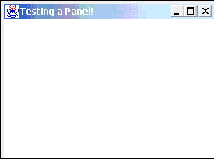
Example
import java.awt.*;
class PanelTest extends Panel
{
public static void main(String args[])
{
PanelTest ObjPanel = new PanelTest();
Frame ObjFr = new Frame("Testing a Panel!");
ObjFr.add(ObjPanel);
ObjFr.setSize(400,400);
ObjFr.setVisible(true);
}
public PanelTest()
{
// write code to override default behavior
}
}
Output

Slide 11
Component
Anything that can be placed on a user interface and can be made visible or resized.
Textfields, Labels, Checkboxes, Textareas are examples of components.
Some advanced components include scrollbars, scrollpanes and dialogs.

Slide 12
Hierarchy of classes in Java
Component
Button
Checkbox
Container
Choice
Canvas
Label
TextComponent
Panel
Window
TextArea
TextField
Applet
Frame
Dialog

Slide 13
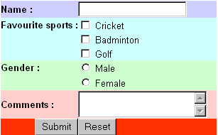
Various components
Label
Text field
Checkbox
Radio button
Text Area
Button

Slide 14
Label
Generally used to indicate the purpose of an item.
Not user-editable.
Can be created using one of the following constructors:
  Label( )
  Creates an empty label
  Label(String labeltext)
  Creates a label with a given text
  Label(String labeltext, int alignment)
  Creates a label with given alignment where alignment
  can be Label.LEFT, Label.RIGHT or Label.CENTER

Slide 15
TextField
GUI element used to input text.
Generally accepts one line of input.
Can be created using one of the following constructors:
  TextField()
  Creates a new textfield
  TextField(int columns)
  Creates a new textfield with given number of columns
  TextField(String s)
  Creates a new textfield with the given string
  TextField(String s, int columns)
  Creates a new textfield with given string and given
  number of columns

Slide 16
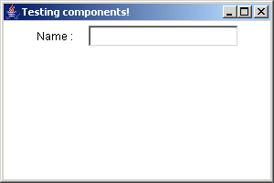
Example
import java.awt.*;
class AcceptName extends Frame
{
TextField txtName = new TextField(20);
Label lblName = new Label("Name :");
public AcceptName (String title)
{
super(title);
setLayout(new FlowLayout());
add(lblName);
add(txtName);
}
public static void main(String args[])
{
AcceptName ObjAccName = new AcceptName ("Testing components!");
ObjAccName.setSize(300,200);
ObjAccName.show();
}
}
Output

Slide 17
TextArea
Used when text is to be accepted as two or more lines.
Includes a scrollbar.
TextArea can be created using one of the following constructors:
  TextArea()
  Creates a new TextArea
  TextArea(int rows, int cols)
  Creates a new TextArea with given number of rows and
  columns
  TextArea(String text)
  Creates a new TextArea with the given string
  TextArea(String text, int rows, int cols)
  Creates a new TextArea with given string, given number
  of rows and columns
  TextArea (String text, int rows, int cols, int scrollbars)
  Creates a new TextArea with the given string, rows and columns, and scroll bar visibility

Slide 18
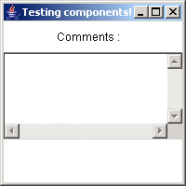
Example
addWindowListener(new WindowAdapter()
{
public void windowClosing(WindowEvent we)
{
setVisible(false);
System.exit(0);
}
});
}
public static void main(String args[])
{
TextComments ObjComment = new TextComments("Testing components!");
ObjComment.setSize(200,200);
ObjComment.show();
}
}
import java.awt.*;
import java.awt.event.*;
class TextComments extends Frame
{
TextArea txtComment = new TextArea(5,25);
Label lblCom = new Label("Comments :");
public TextComments(String title)
{
super(title);
setLayout(new FlowLayout());
add(lblCom);
add(txtComment);
Output

Slide 19
Buttons
Part of GUI
The easiest way to trap user action.
Can create buttons in Java using any of the following constructors
  Button()
  Creates a new Button.
  Button(String text)
  Creates a new Button with the given String.

Slide 20
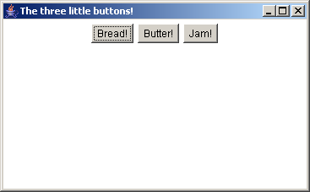
Example
addWindowListener(new WindowAdapter()
{
public void windowClosing(WindowEvent we)
{
setVisible(false);
System.exit(0);
}
});
}
public static void main(String args[])
{
ButtonTest ObjTest = new ButtonTest("The three little buttons!");
ObjTest.setSize(500,500);
ObjTest.show();
}
}
import java.awt.*;
import java.awt.event.*;
class ButtonTest extends Frame
{
Button btnBread = new Button("Bread!");
Button btnButter = new Button("Butter!");
Button btnJam = new Button("Jam!");
public ButtonTest(String title)
{
super(title);
setLayout(new FlowLayout());
add(btnBread);
add(btnButter);
add(btnJam);
Output

Slide 21
Checkbox
Used for multi-option user input that the user may select or deselect by clicking on them.
Checkboxes in Java can be created using one of the following constructors:
  Checkbox()
  Creates an empty textbox.
  Checkbox(String text)
  Creates a checkbox with given string as label.
  Checkbox(String text, boolean on)
  Creates a checkbox with given string as label and also allows
  to set the state of the check box by setting the value of the
  boolean variable as true or false.

Slide 22
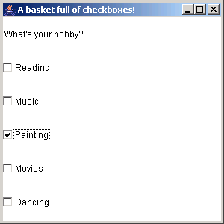
Example
addWindowListener(new WindowAdapter()
{
public void windowClosing(WindowEvent we)
{
setVisible(false);
System.exit(0);
}
});
}
public static void main(String args[])
{
Hobbies ObjHobby = new Hobbies ("A basket full of checkboxes!");
ObjHobby.setSize(300,300);
// Objhobby.pack();
ObjHobby.show();
}
}
import java.awt.*;
import java.awt.event.*;
class Hobbies extends Frame
{
Checkbox cboxRead = new Checkbox("Reading",false);
Checkbox cboxMus = new Checkbox("Music",false);
Checkbox cboxPaint = new Checkbox("Painting",false);
Checkbox cboxMovie = new Checkbox("Movies",false);
Checkbox cboxDance = new Checkbox("Dancing",false);
Label lblQts = new Label("What's your hobby?" );
public Hobbies(String str )
{
super(str);
setLayout(new GridLayout(6,1));
add(lblQts);
add(cboxRead);
add(cboxMus);
add(cboxPaint);
add(cboxMovie);
add(cboxDance);
Output

Slide 23
Radiobuttons
Used as option button to specify choices.
Only one button in a radiobutton group can be selected.
First create a CheckboxGroup object
  CheckboxGroup cg=new CheckboxGroup();
Then create each of the radio buttons
  Checkbox male=Checkbox(“male”,cg,true);
  Checkbox female=Checkbox(“female”,cg,false);

Slide 24
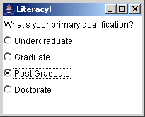
Example
import java.awt.*;
import java.awt.event.*;
class Qualification extends Frame
{
CheckboxGroup cg = new CheckboxGroup();
Checkbox radUnder = new Checkbox("Undergraduate",cg,false);
Checkbox radGra = new Checkbox("Graduate",cg,false);
Checkbox radPost = new Checkbox("Post Graduate",cg,false);
Checkbox radDoc = new Checkbox("Doctorate",cg,false);
Label lblQts = new Label("What's your primary qualification?" );
public Qualification(String str)
{
super(str);
setLayout(new GridLayout(6,1));
add(lblQts);
add(radUnder);
add(radGra);
add(radPost);
add(radDoc);
addWindowListener(new WindowAdapter()
{
public void windowClosing(WindowEvent we)
{
setVisible(false);
System.exit(0);
}
});
}
public static void main(String args[])
{
Qualification ObjQualification = new Qualification ("Literacy!");
ObjQualification.pack();
ObjQualification.show( );
}
}
Output

Slide 25
Lists
Displays a list of choices to the user.
User may select one or more items.
Created using a number of strings or text values.
Choice class enables us to create multiple item lists. The syntax for creating is:
  Choice moviestars=new Choice();
Items are added using the addItem() method as shown:
  moviestars.addItem(“Antonio Banderas”);
  moviestars.addItem(“Leonardo Dicaprio”);

Slide 26
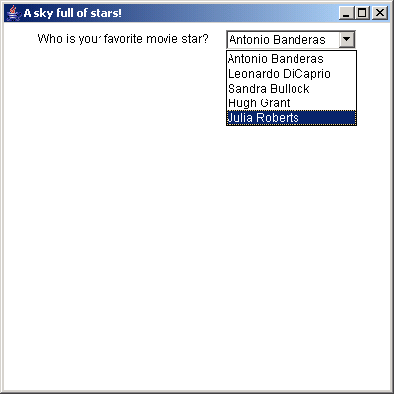
Example
import java.awt.*;
import java.awt.event.*;
class Stars extends Frame
{
Choice moviestars = new Choice();
Label lblQts = new Label("Who is your favorite movie star?");
public Stars(String str)
{
super(str);
setLayout(new FlowLayout());
moviestars.addItem("Antonio Banderas");
moviestars.addItem("Leonardo DiCaprio");
moviestars.addItem("Sandra Bullock");
moviestars.addItem("Hugh Grant");
moviestars.addItem("Julia Roberts");
add(lblQts);
add(moviestars);
Output
addWindowListener(new WindowAdapter()
{
public void windowClosing(WindowEvent we)
{
setVisible(false);
System.exit(0);
}
});
}
public static void main(String args[])
{
Stars ObjStar = new Stars ("A sky full of stars!");
ObjStar.setSize(400,400);
ObjStar.show();
}
}

Slide 27
Event handling with Components
Events are generated whenever a user clicks a mouse, presses or releases a key.
Event Delegation Model is used to handle events.
This model allows the program to register handlers called ‘listeners’ with objects whose events need to be captured.
Handlers are automatically called when an event takes place.
Action that has to be done following an event is performed by the respective listener.

Slide 28
Event handling with components Contd…
Event listeners are implemented as interfaces in Java.
Steps to be followed for using the Event Delegation Model are:
  Associate the class with the appropriate listener interface.
  Identify all components that generate events.
  Identify all events to be handled.
  Implement the methods of the listener and write the event handling code within the methods.

Slide 29
MouseEvent and WindowEvent
Frame is a subclass of Component, it inherits all the capabilities of the Component class.
Frame window can be managed just like any other window.

Slide 30
KeyboardFocusManager
APIs for FocusEvent and WindowEvent were insufficient because there was no way to find out which Component was involved in focus or activation change.
To take care of this, a new centralized KeyboardFocusManager class was developed.
There are sets of APIs that the client code can use to find out about the current focus state, to initiate focus changes and replace default focus event dispatcher with a custom dispatcher.

Slide 31
Concepts of KeyboardFocusManager
Focus Owner
Permanent focus owner
Focused Window
Active Window
Focus Traversal
Focus Traversal cycle
Focus Cycle Root

Slide 32
Six Event Types Defined By AWT
WindowEvent.WINDOW_ACTIVATED
WindowEvent.WINDOW_GAINED_FOCUS
FocusEvent.FOCUS_GAINED
FocusEvent.FOCUS_LOST
WindowEvent.WINDOW_LOST_FOCUS
WindowEvent.WINDOW_DEACTIVATED

Slide 33
Event Delivery
If the user clicks on a focusable child component called a which is present on an inactive Frame called b then the order in which the events will be dispatched is in this manner:
  Firstly b will receive a WINDOW_ACTIVATED event.
  Next b will receive a WINDOW_GAINED_FOCUS event
  Lastly, Component a will receive a FOCUS_GAINED event.
Before the next event can be dispatched, the first event dispatched has to be fully handled. There will be a one-to-one correspondence between the opposite events.

Slide 34
Focus Traversal
For focus traversal operation, each Component has its own set of traversal keys. The Component has different sets of keys for forward and backward movement as well as for traversal up or down the cycle.
To traverse forward to the next Component:
  TextAreas: Ctrl+Tab on KEY_PRESSED
To traverse backward to the previous Component:
  TextAreas: Ctrl+Shift+Tab on KEY_PRESSED
To traverse up one focus traversal cycle: none
To traverse down one focus traversal cycle: none

Slide 35
Focus Traversal Policy
Focus Traversal Policy defines the order in which the components with a particular focus cycle root are traversed.
Each FocusTraversalPolicy must define the following alogorithm:
  Given a focus cycle root and a Component a in that cycle , the next Component after a
  Given a focus cycle root and a Component a in that cycle , the previous component before a
  In a focus cycle root, the “first” Component
  In a focus cycle root, the “last” Component
  In a focus cycle root, the “default” Component. It can be the same as the “ first” Component

Slide 36
FocusTraversalPolicy Standard
The two standard FocusTraversalPolicy that can be implemented by the clients are:
  ContainerOrderFocusTraversalPolicy
  DefaultFocusTraversalPolicy

Slide 37
Programmatic Traversal
Programmatically a client can also write the traversal policy.
To initiate a programmatic traversal, methods of KeyboardFocusManager can be used. They are:
  KeyboardFocusManager.focusNextComponent()
  KeyboardFocusManager.focusPreviousComponent()

Slide 38
Summary
The Abstract Window Toolkit (AWT) is a set of classes that allow us to create a graphical user interface and accepts user input through the keyboard and the mouse.
A component is anything that can be placed on a user interface and be made visible or resized.
Commonly used examples of components are Textfields, Labels, Checkboxes, Textareas.
Frame and Panel are commonly used containers for standalone applications.
A Panel is generally used to group many smaller components together.
To handle events, first associate the class with the appropriate listener interface.
Identify the components that generate the events. The components can be a button, label, menu item or a window.

Slide 39
Summary Contd…
Identify all the events to be handled. For instance the events can be ActionEvent if a button is clicked or a MouseEvent if the mouse is dragged.
Implement the methods of the listener and write the event handling code within the methods.
KeyboardFocusManager class was developed to know which component GAINED_FOCUS or LOST_FOCUS. It was added in the Java 1.4 version.
Events are dispatched in an orderly manner. One event has to be fully handled before another event can be handled.
Each component has its own set of Keys for traversing.
ContainerOrderFocusTraversalPolicy and DefaultFocusTraversalPolicy are the two standard FocusTraversalPolicy which can be implemented by the client.
Programmatic traversal is also possible by using methods of KeyboardFocusManager class.

